Slide 1

User Experience (UX) Analysis for Flex Trade Online Shopping App

Slide 2

BUSINESS OVERVIEW
FlexTrade is a well-known company in the online shopping world. They have been making shopping easier and better for a long time. They sell all kinds of things, from electronics to clothes.
Their app is designed to be easy to use, hoping to make shopping fun and simple for everyone.
FlexTrade wants to keep improving their app to make sure they stay ahead in the competitive online shopping market. This project looked into how they can make the app even better for users.

Slide 3
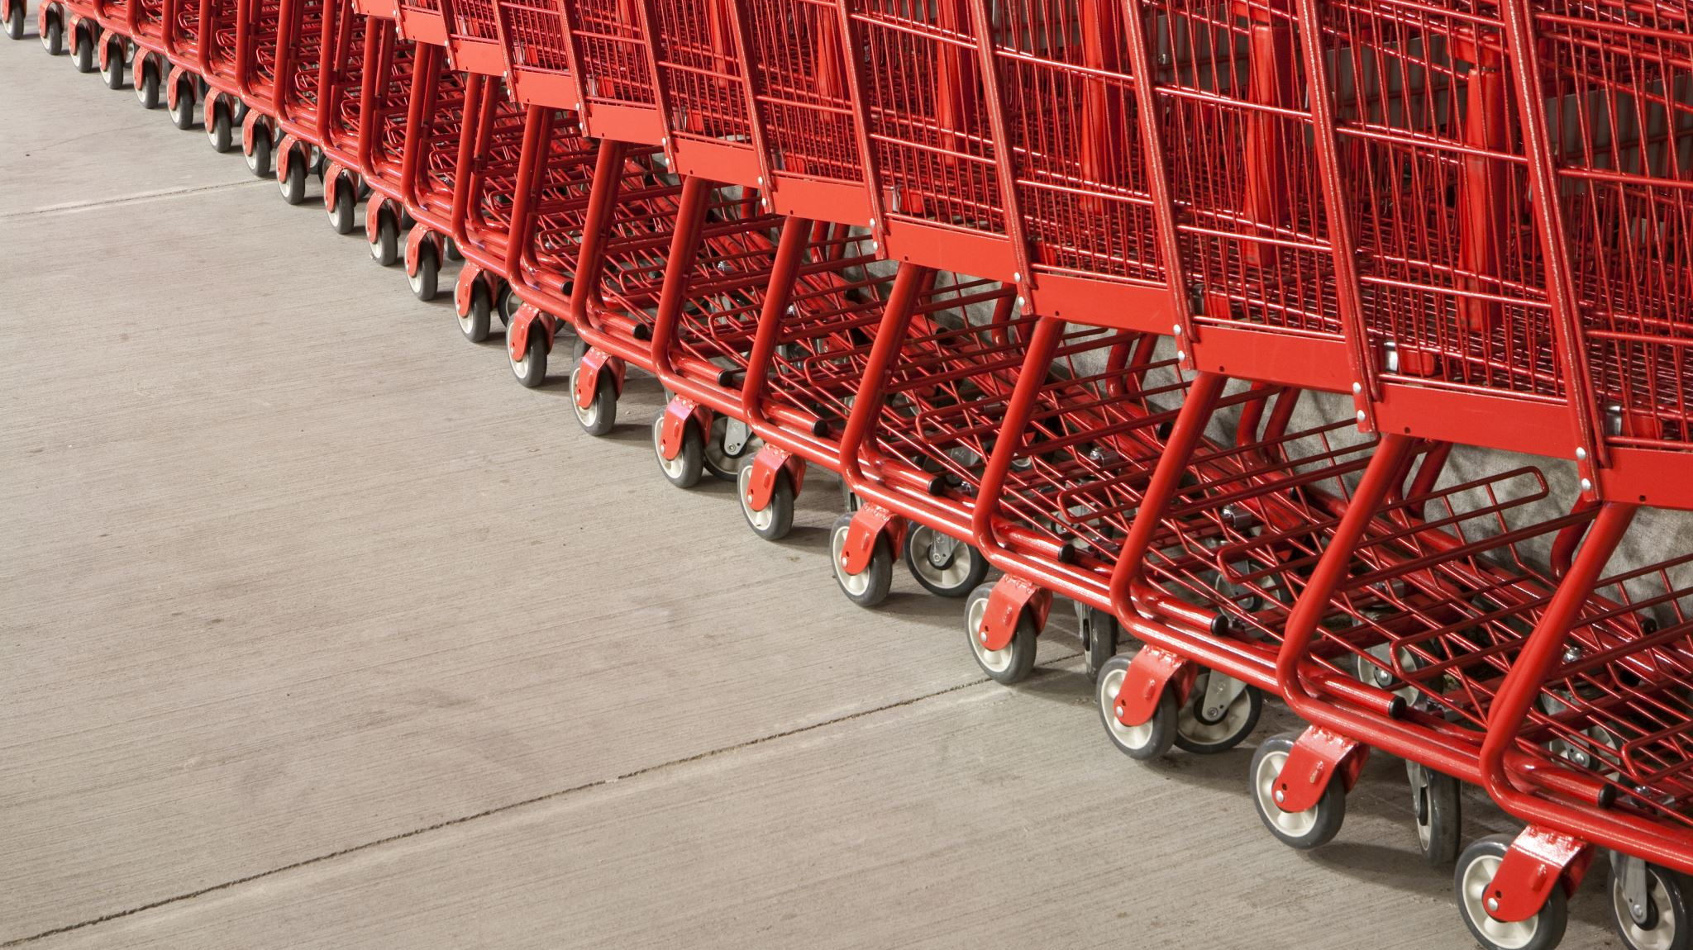
BUSINESS PROBLEM
Even though lots of people download and use the FlexTrade app, not everyone ends up buying
something. Few problems that customers face are:
● High Bounce Rate: Many users leave the app quickly without buying anything.
● Cart Abandonment: Users put items in their cart but don't complete the purchase.
● Low Average Order Value: The amount of money users spend is lower than what FlexTrade
would like.
● Lots of Competition: There are many other shopping apps out there, so FlexTrade needs to
stand out.

Slide 4
AIM OF THE PROJECT
Find UX problems: look at how users behave and what they say to find out what needs to be better.
Make checkout better: make it easier and quicker for users to buy things.
Suggest personalized products: use what we know about what users like to suggest other things they might buy.
Get users to buy more: figure out ways to encourage users to spend more money.

Slide 5
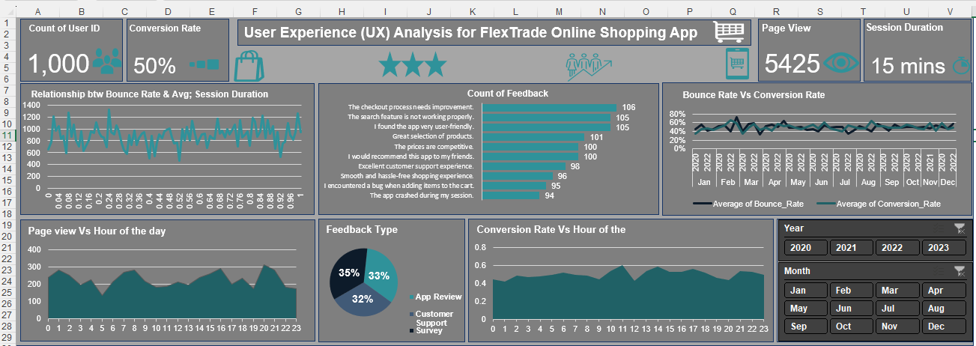
DASHBOARD

Slide 6
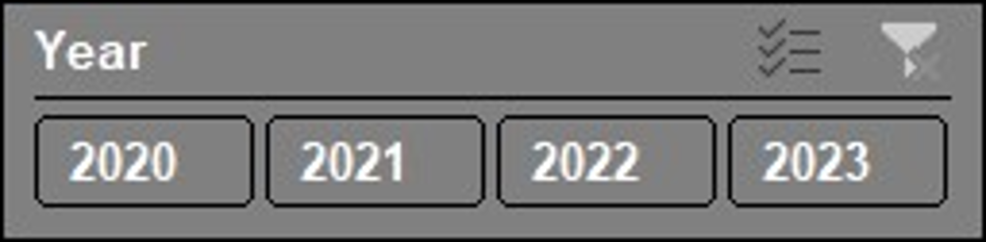
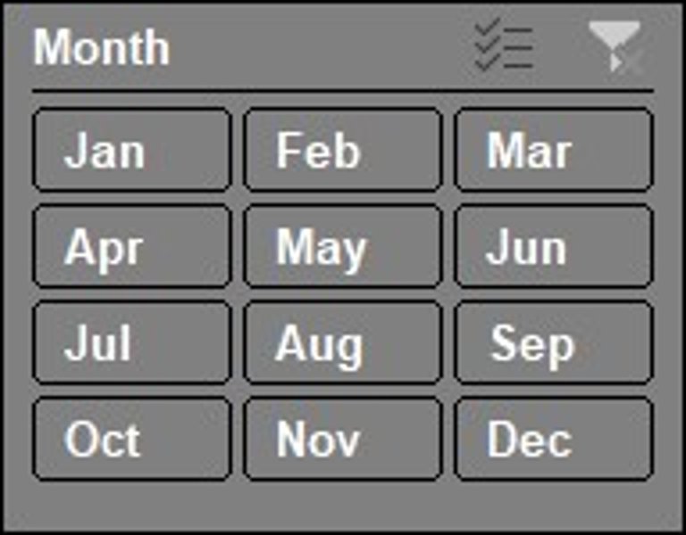




Additional Visualizations
KEY PERFORMANCE INDICATORS
.

Slide 7
Comparing The Conversion Rate With The Page View Using The Hour Of The Day As A Measure
And the highest conversion rate happened at 11:00am.
At the hour of 20:00, customers viewed the page the most.

Slide 8
Count of Feedback and the Feedback Type Received

Slide 9
Bounce Rate Vs Conversion Rate
It shows here that as the bounce rate goes up, the conversion rate comes down and vice versa. This shows that they both have a negative correlation

Slide 10
Recommendations
Based on the analysis, the feedback given by the customer shows that the checkout needs to be improved as well as the search feature as these appeared to be the top 2 feedback we received.
Comparing the page view and the conversion rate, though the total number of page view was 5425, this does not mean all customers that viewed the page purchased a product on the app and this is due to issues like, bugs, checkout issues, app crashing,& search button not providing customers with the right algorithm, the conversion rate turned out to be just 50%.
It also shows that the average session duration spent by customers is 15 minutes, I recommend the issues highlighted above are worked so the customers can checkout as quickly as they can.
For the checkout as well, if not in place, checkout should happen on the application without taking customers to another website so the customers won’t have to leave the app before they can checkout as quickly as they can, and this will have positive impact on the conversion rate
Also to boost sales, promotional activities like getting vouchers or points for purchasing up to a certain amount, referral bonus, loyalty gifts etc should be introduced.

